Slide 1
Math 152
Lesson | Topic | Reading
39 | Dot Product | 12.3
40 | Cross Product | 12.4
 | Final
Objectives:
Calculate the cross product of two vectors. Understand that the cross- product is a vector
Use a x b to calculate an orthogonal vector to both a and b
Use the Cross Product to calculate torque

Slide 2
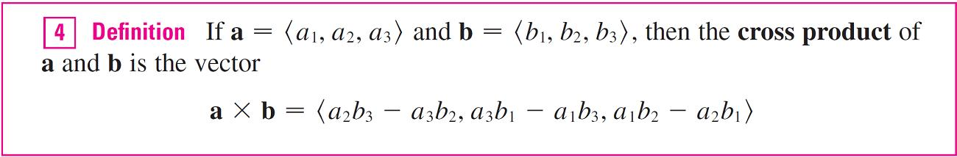
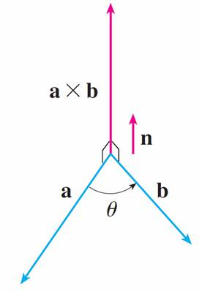
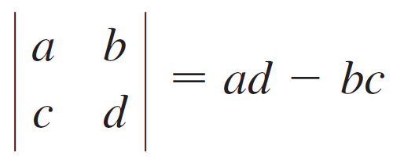
Cross Product
Where:
Right-hand Rule

Slide 3
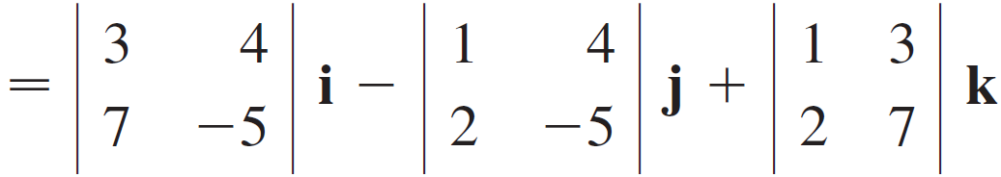
Example
If a = ⟨1, 3, 4⟩ and b = ⟨2, 7, –5⟩, then
= (–15 – 28)i – (–5 – 8)j + (7 – 6)k = –43i + 13j + k

Slide 4
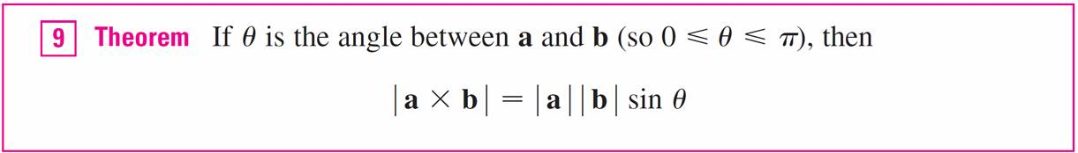
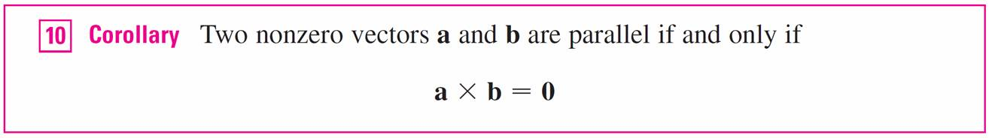
Properties

Slide 5
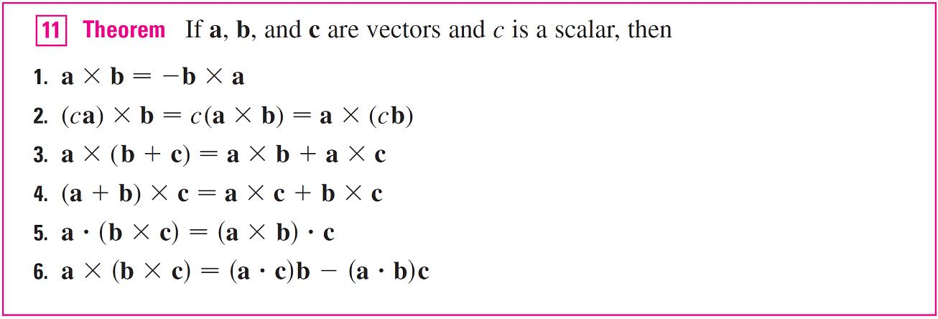
Properties
Triple Product

Slide 6
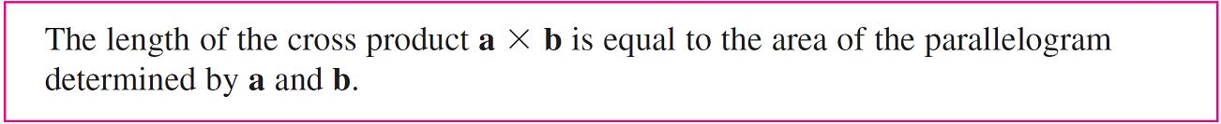
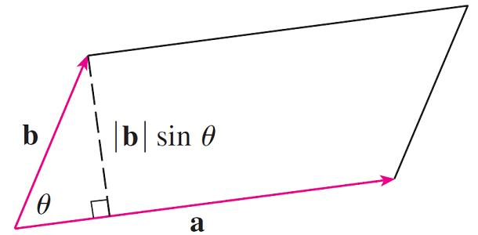
Geometry
A = | a |(| b |sin θ) = | a × b |

Slide 7
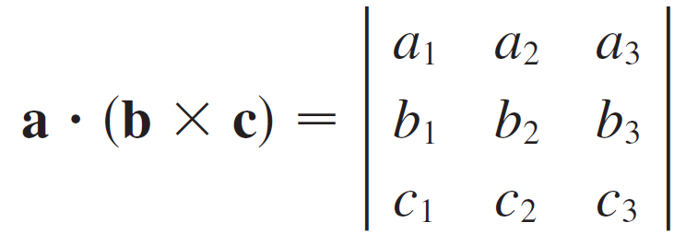
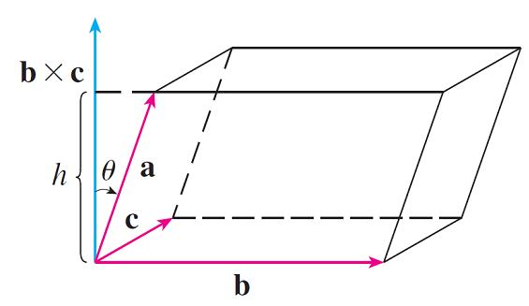
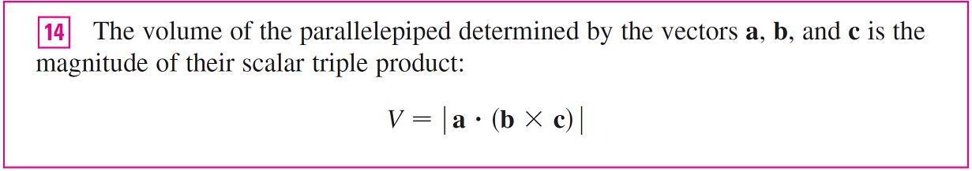
Triple Product
Note: if a is a basis vector, then this is normal cross product
The area of the base parallelogram is A = | b × c |

Slide 8
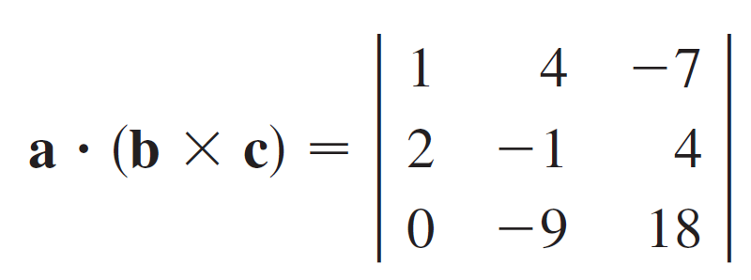
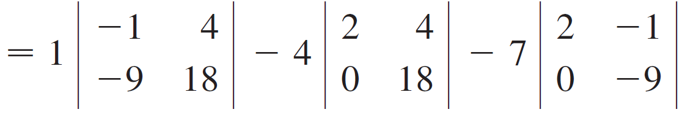
Example
Use the scalar triple product to show that the vectors a = ⟨1, 4, –7⟩, b = ⟨2, –1, 4⟩, and c = ⟨0, –9, 18⟩ are coplanar.
Solution:
= 1(18) – 4(36) – 7(–18) = 0

Slide 9
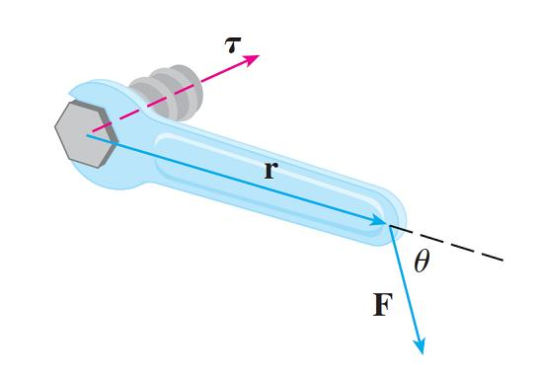
Torque
The idea of a cross product occurs often in physics. In particular, we consider a force F acting on a rigid body at a point given by a position vector r.
τ = r × F
| τ | = | r × F | = | r || F | sin θ

Slide 10
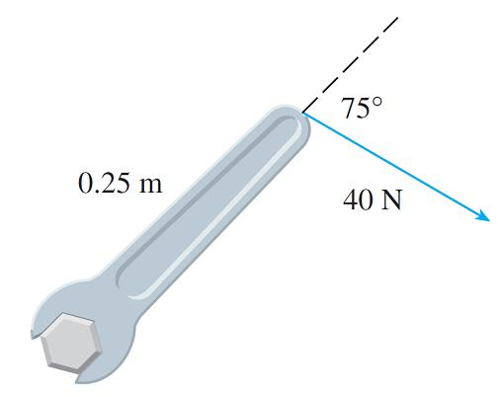
Example
Find the magnitude of the Torque
Solution:
|τ | = | r × F | = | r || F | sin 75°
= (0.25)(40) sin 75°
= 10 sin 75° ≈ 9.66 Nm

Slide 11
Backups

Slide 12
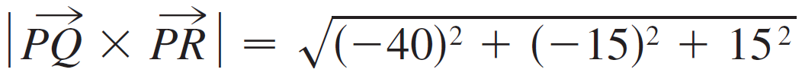
Example
Find the area of the triangle with vertices P (1, 4, 6), Q (–2, 5, –1), and R (1, –1, 1).
Solution: In Example 3 we computed that PQ × PR = ⟨–40, –15, 15⟩. The area of the parallelogram with adjacent sides PQ and PR is the length of this cross product:
The area A of the triangle PQR is half the area of this parallelogram, that is, .

